Slide 1
Episodic Memory for Soar
Andrew Nuxoll
15 June 2005

Slide 2
Outline
Review
  Definitions and previous work
  Improving agent behavior
Improving Performance
  Two algorithms for memory retrieval
  Memory usage
  Processing time

Slide 3
What is Episodic Memory?
Memories of specific events in our past
  Example: Your last vacation

Slide 4
Previous Work
Psychology
  Observations of Humans - Endel Tulving
Cognitive Modeling
  Soar Model (non-architectural) - Erik Altmann
Artificial Intelligence
  Continuous CBR - Ram and Santamaría
  Comprehensive Agents - Vere and Bickmore
Notes:
CBR implementations are often domain specific in order to reduce matching complexity and simplify when episodes are recorded. There are exceptions, most notably Continuous CBR which bears a lot of resemblance to our research.

Slide 5
Current Implementation
Long-term Procedural Memory
Production Rules
Encoding
Initiation?
Storage
Retrieval
Output
Working Memory
Cue
Input
Retrieved
When the agent takes an action.

Slide 6
Current Implementation
Long-term Procedural Memory
Production Rules
Encoding
Initiation
Content?
Storage
Retrieval
Output
Working Memory
Cue
Input
Retrieved
A portion of working memory is stored in the episode

Slide 7
Current Implementation
Long-term Procedural Memory
Production Rules
Episodic
Memory
Encoding
Initiation
Content
Storage
Episode Structure?
Retrieval
Output
Working Memory
Cue
Episodic
Learning
Input
Retrieved
Episodes are stored in a separate memory

Slide 8
Current Implementation
Long-term Procedural Memory
Production Rules
Episodic
Memory
Encoding
Initiation
Content
Storage
Episode Structure
Retrieval
Initiation/Cue?
Output
Working Memory
Cue
Episodic
Learning
Input
Retrieved
Cue is placed in an architecture specific buffer.

Slide 9
Current Implementation
Long-term Procedural Memory
Production Rules
Episodic
Memory
Encoding
Initiation
Content
Storage
Episode Structure
Retrieval
Initiation/Cue
Retrieval
Output
Working Memory
Cue
Episodic
Learning
Input
Retrieved
The closest partial match is retrieved.

Slide 10
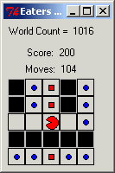
Evaluation using Eaters
Pac-Man-like
Two types of food
  Bonus food (10 pts)
  Normal food (5 pts)

Slide 11



An Episodic Memory Eater
Evaluate moving in each available direction
Create a memory cue (input-link + proposed direction)
Retrieve the best matching memory
Retrieve the next memory (in temporal order)
Use the change in score to evaluate the proposed action
East
North
Move North = 10 points
South
Episodic
Retrieval
Retrieve
Next Memory

Slide 12
Working Memory Activation
Used to bias the match at retrieval time
  Nuxoll, A., Laird, J., James, M. (2004). Comprehensive Working Memory Activation in Soar. International Conference on Cognitive Modeling.

Slide 13
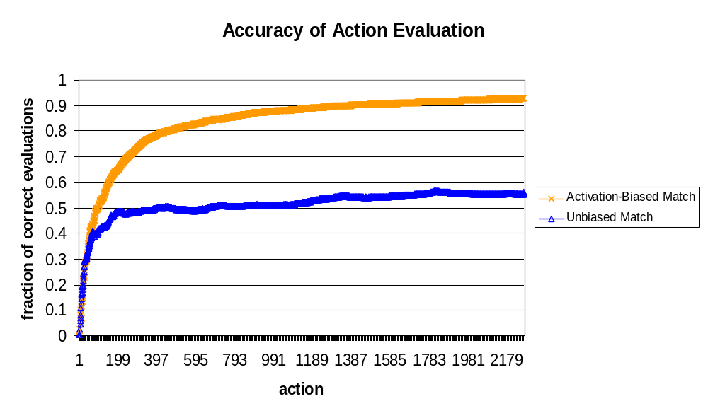
Effects of Memory Activation Bias

Slide 14
New Business: Improving Performance
Memory Usage
Processing Time

Slide 15
Two Algorithms for Retrieval
Instance-Based
  Store a complete list of each WME in each memory
Interval-Based
  Store the duration of each WME (i.e., what cycles during which it existed)

Slide 16
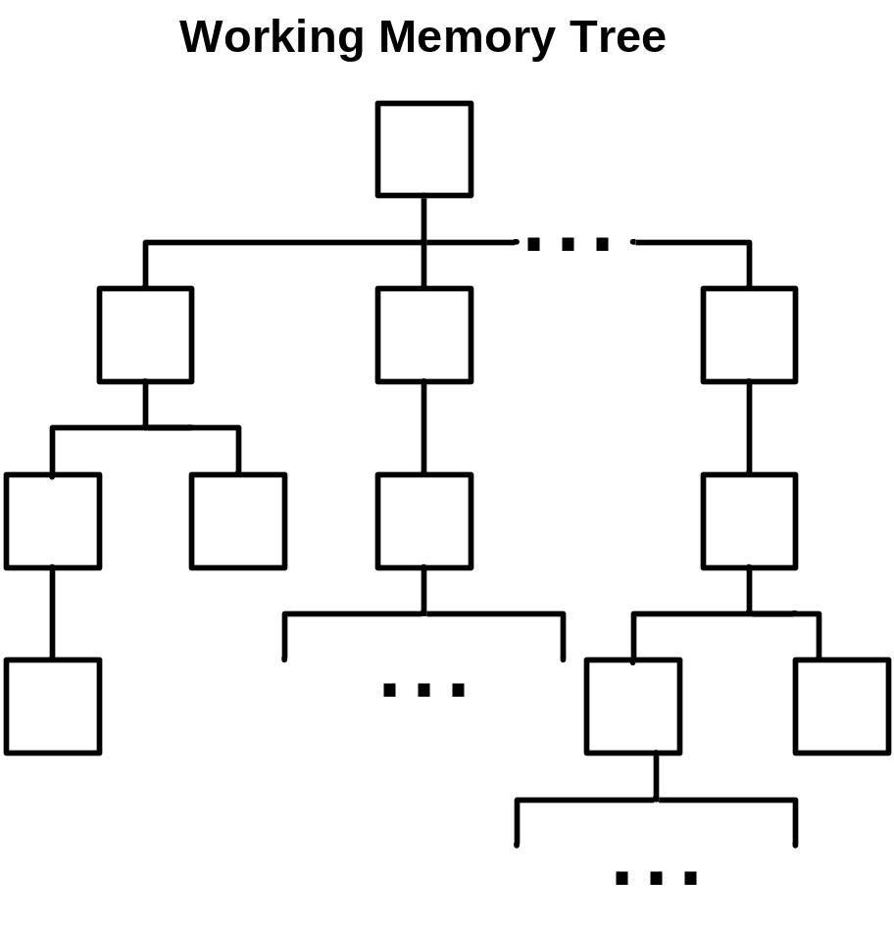
Instance-Based Retrieval Algorithm

Slide 17
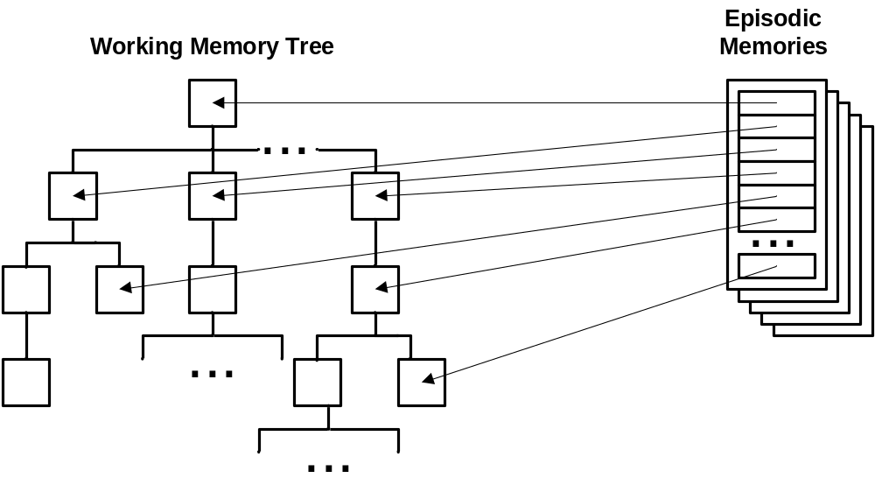
Instance-Based Retrieval Algorithm

Slide 18
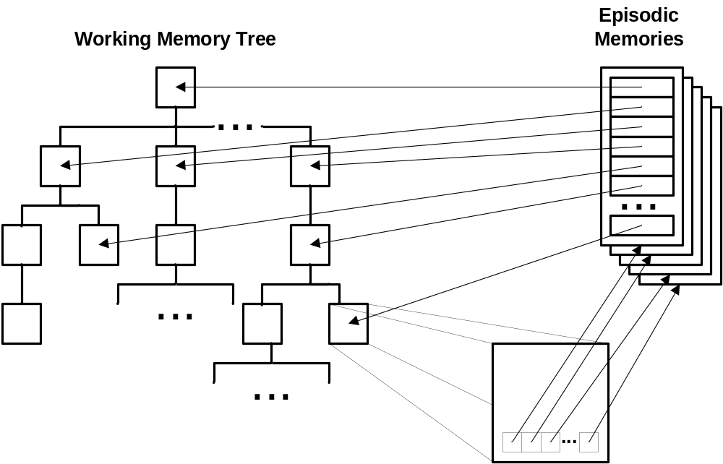
Instance-Based Retrieval Algorithm

Slide 19
Instance-Based Retrieval Algorithm
Traverse the cue and find each corresponding node in the working memory tree
Add each memory referenced by the node to a list
Compare the cue to each entry in the list

Slide 20
Interval-Based Retrieval Algorithm

Slide 21
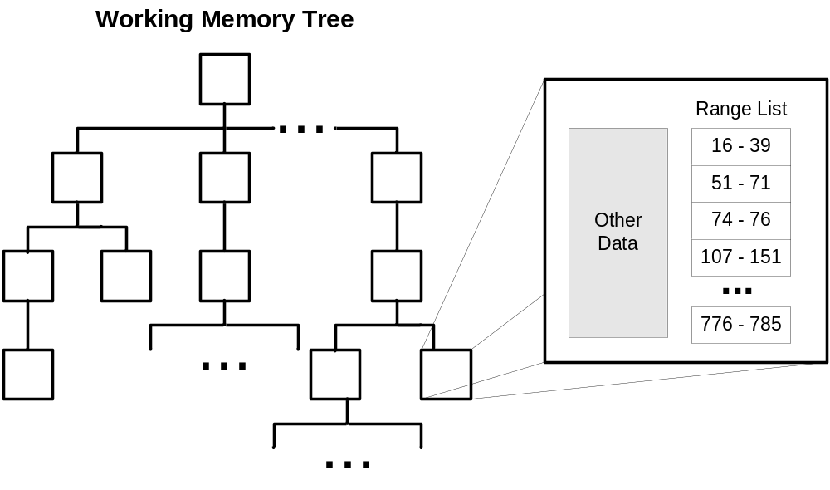
Interval-Based Retrieval Algorithm
O(n²l)

Slide 22
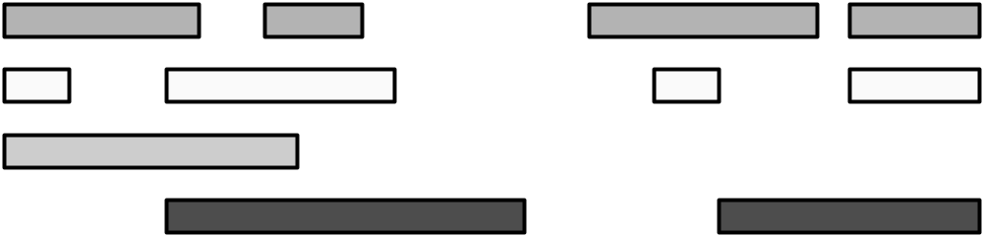
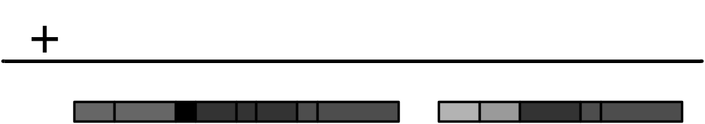
Interval-Based: Merging Ranges

Slide 23
Interval-Based Retrieval Algorithm
Traverse the cue and find each corresponding node in the working memory tree
The range list associated with each node is assigned the cue’s activation level.
Merge all the range lists associated with each node. Overlapping ranges are split
Traverse the merged list to find the interval with the highest activation
Traverse the working memory tree to recreate the memory during that interval

Slide 24
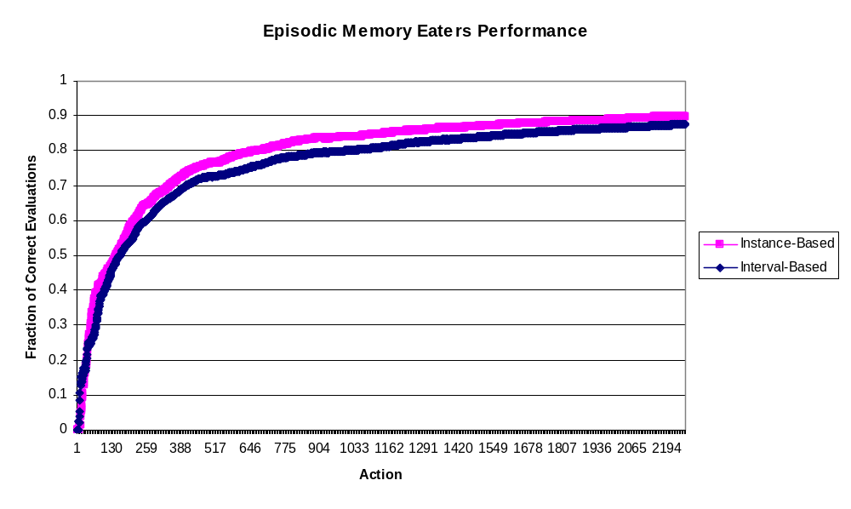
Memory-Bias vs. Cue-Bias

Slide 25
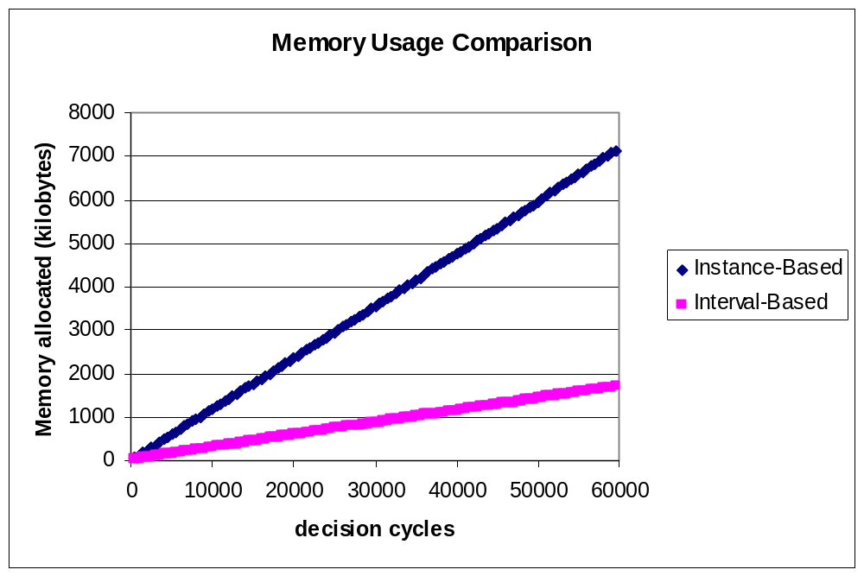
Memory Usage

Slide 26
Evaluating Memory Usage
Rough Order of Magnitude Calculation
  Varies based upon agent and task
One new episode per 150ms (3 cycles)
  55MB or 210MB per 24 hours
One new episode per 5-10 seconds
  <10 MB per 24 hours

Slide 27
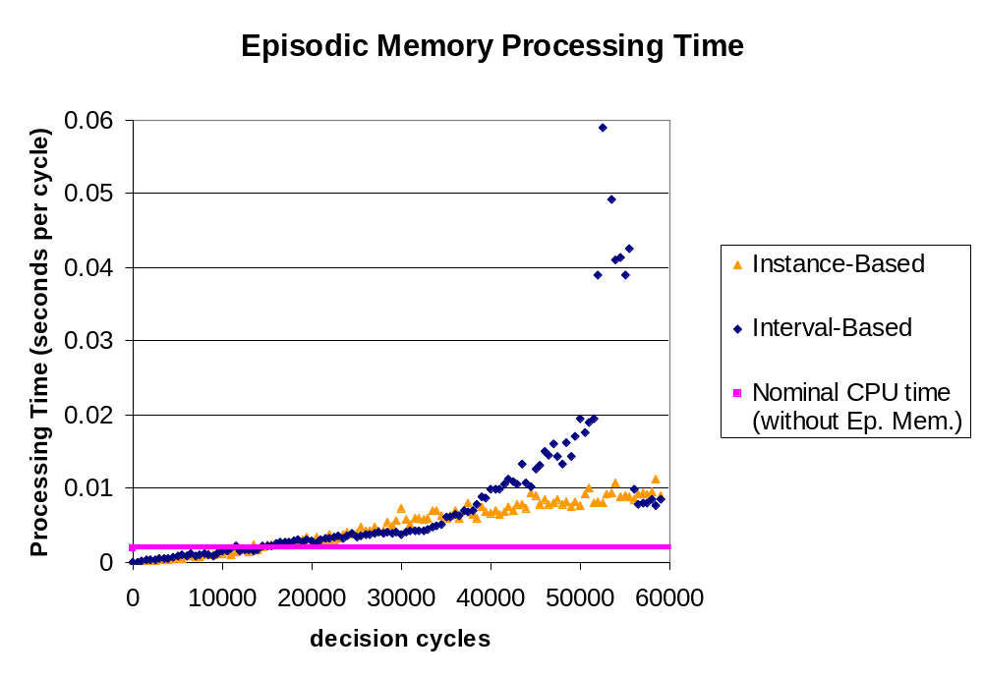
Processing Time

Slide 28
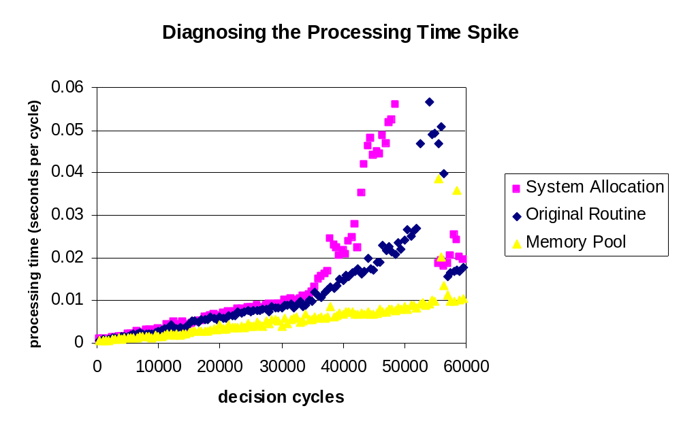
Diagnosing “The Spike”

Slide 29
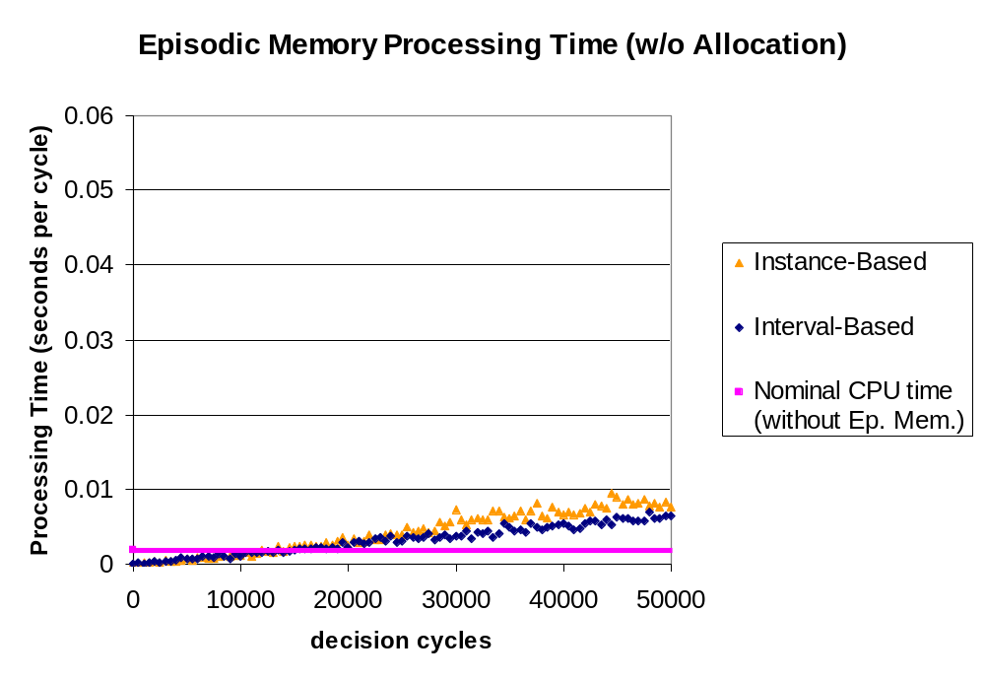
Processing Time Potential

Slide 30
Evaluating Processing Time
Rough Order of Magnitude Calculation
  Varies based upon agent and task
Worst Case (primitive action level):
  One new episode per 150ms (3 cycles)
  Maximum of 50ms allowed for retrieval
  Result: Limit exceed after four hours (115,000 cycles)
Best Case (human level):
  One new episode every 5-10 seconds
  Maximum of 0.1 to 5 seconds allowed for retrieval
  Result: Limited exceeded in ~1 year

Slide 31
Nuggets Coal
Domain independent, architectural implementation
Potential for effective performance
Performance glitches
Needs to be tested in multiple domains

